Slide 1
Fault Diagnosis of Electric Vehicle Motors using ANSYS integrated with Machine Learning (BLDC)
CB.EN.U4EEE22062 CB.EN.U4EEE22064 CB.EN.U4EEE22066

Slide 2
contents
Introduction
Objective
Methodology
Results
Conclusion
Reference

Slide 3
Introduction
Electric vehicles (EVs) have gained significant popularity due to their efficiency, sustainability, and reduced environmental impact. At the heart of these vehicles, Brushless DC (BLDC) motors play a crucial role in ensuring smooth and efficient operation. However, like any mechanical and electrical system, BLDC motors are susceptible to various faults that can affect performance, safety, and longevity.
Fault diagnosis in BLDC motors is essential to detect and prevent failures before they lead to major breakdowns. Common faults include electrical faults (such as short circuits or open windings), mechanical faults (such as bearing failure or rotor misalignment), and magnetic faults (such as permanent magnet demagnetization). These faults can cause efficiency loss, overheating, noise, and even complete motor failure if left undiagnosed.

Slide 4
Objective
The main objective of this study is to analyze and diagnose faults in Brushless DC (BLDC) motors used in electric vehicles (EVs) through ANSYS simulation tools. BLDC motors are critical components in EVs, and their performance can be significantly affected by various faults, including electrical faults (such as short circuits and open windings), mechanical faults (such as rotor misalignment and bearing failure), and magnetic faults (such as demagnetization of permanent magnets). Identifying these faults at an early stage is crucial for ensuring the efficiency, reliability, and safety of electric vehicles.
By utilizing ANSYS Maxwell for finite element analysis (FEA), this study aims to simulate different fault conditions in BLDC motors and assess their impact on key performance parameters such as torque, efficiency, temperature, and vibrations. The objective is to compare faulty and normal motor operations, identify early warning signs, and propose fault detection techniques that can be used for predictive maintenance. Additionally, the study seeks to optimize BLDC motor design by evaluating fault-prone areas and suggesting improvements to enhance durability and performance.

Slide 5
Methodology
The methodology for diagnosing faults in Brushless DC (BLDC) motors using ANSYS involves a structured approach, including motor modeling, fault simulation, and performance analysis. This process ensures a detailed understanding of fault mechanisms and their impact on motor efficiency, reliability, and safety.
The first step involves developing a 3D model of the BLDC motor using ANSYS Maxwell. This model includes essential components such as the stator, rotor, windings, and permanent magnets to ensure accurate electromagnetic analysis. Once the model is created, the next step is defining operating conditions, including supply voltage, load torque, and speed, to simulate real-world EV motor performance.
After setting up the healthy motor model, various fault conditions are introduced to analyze their effects on performance. These faults include electrical faults (such as phase-to-phase short circuits and open winding faults), mechanical faults (such as rotor imbalance and bearing defects), and magnetic faults (such as demagnetization of permanent magnets).

Slide 6
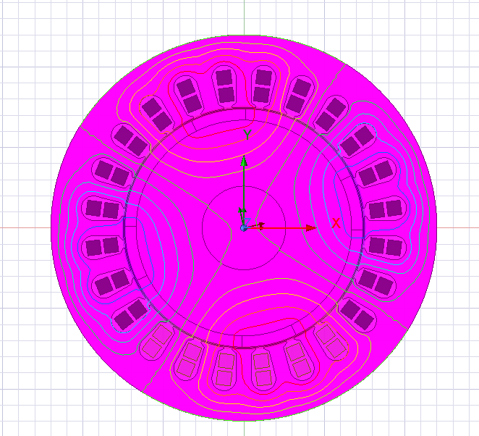
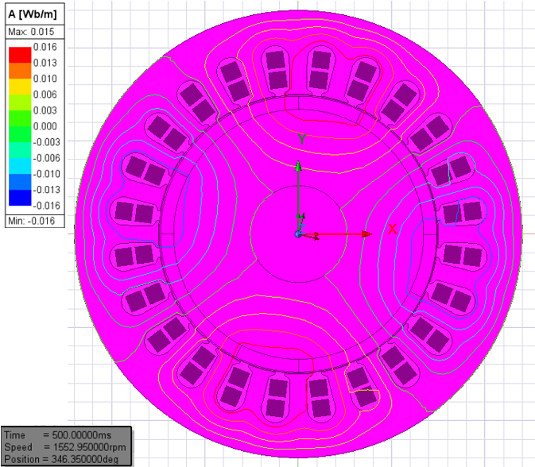
Results
Simulation of Healthy
Simulation of 0.1mm eccentricity(20%)

Slide 7
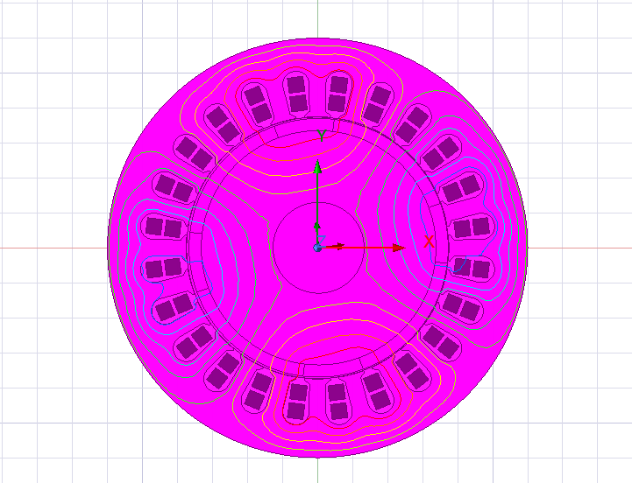
Simulation of 0.3mm eccentricity(60%)

Slide 8
Radial flux density
The radial flux density in the BLDC motor is determined by the product of the air gap permeance and the sum of the stator and rotor magnetomotive forces (MMF).
The radial flux density in the air gap of the BLDC motor is analyzed for the healthy condition and different levels of dynamic eccentricity (20% and 60%), as shown in the figures. By comparing the RMS flux density at the aligned stator and rotor positions, it is observed that as the severity of eccentricity increases, the RMS radial flux density changes due to variations in the air gap at each instant.
In the healthy BLDC motor, the RMS flux density is 0.6174 Wb/m², and the flux distribution remains uniform with consistent positive and negative peaks. However, in the presence of a 20% eccentricity fault, the RMS flux density decreases slightly to 0.6088 Wb/m², and further distortions in the flux distribution are observed. For the 60% eccentricity fault, the RMS flux density shows more significant fluctuations, with values dropping to 0.5871 Wb/m², indicating a more pronounced impact on the flux distribution due to the increased air gap variation.

Slide 9
Table : Radial Airgap Flux Density Comparison – Healthy vs. Faulty BLDC Motor
Percentage of Fault | Airgap Flux (Wb/m²)
Healthy | 0.6174
20% Fault | 0.6088
60% Fault | 0.5871
Here is the table for rotor part displacement corresponding to different eccentricity percentages:
Eccentricity (%) | Rotor Part Displacement (mm)
20% | 0.10
40% | 0.20
60% | 0.30

Slide 10
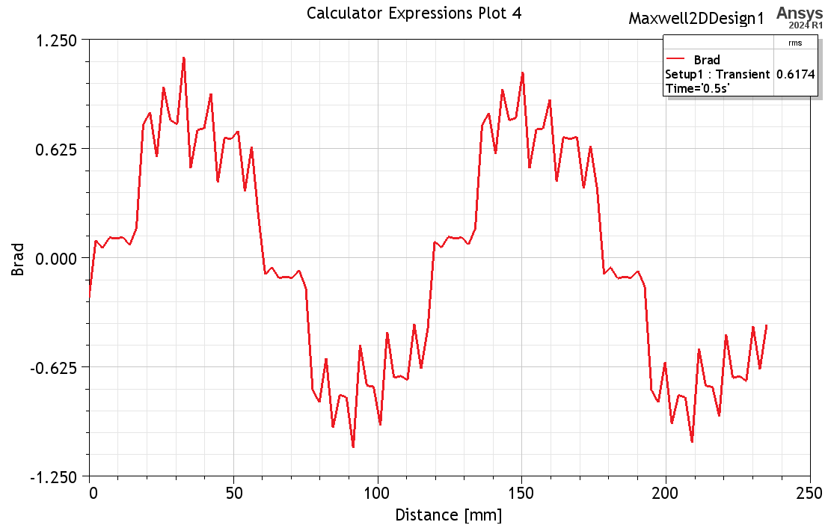
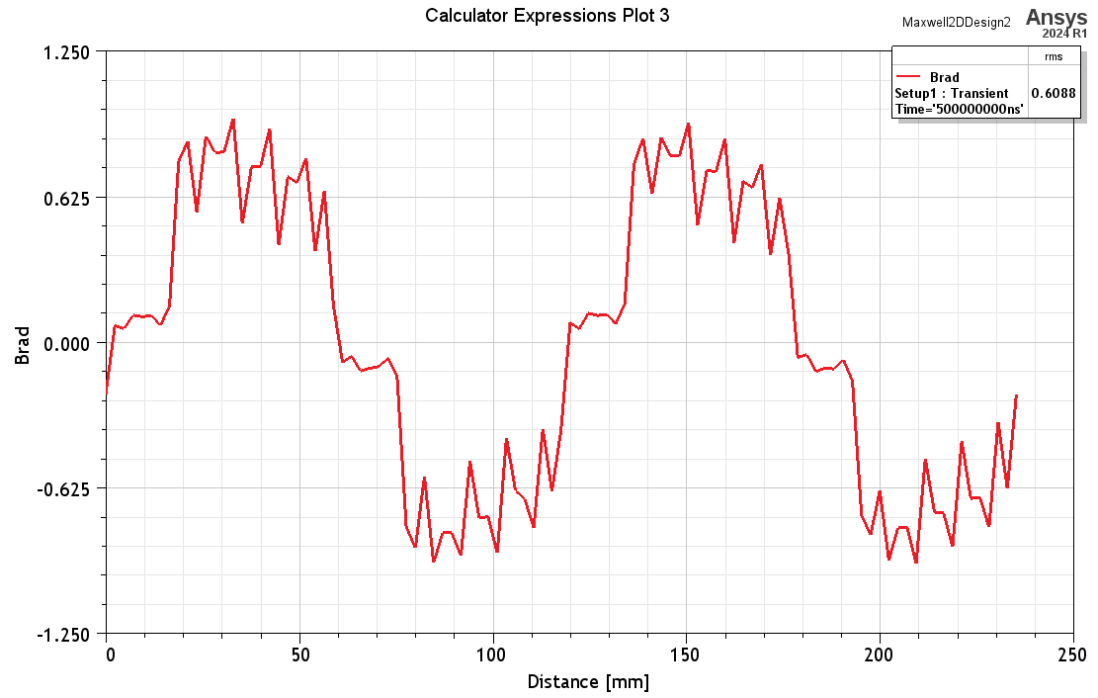
Radial flux density graphs
Healthy
0.1mm eccentricity fault(20%)

Slide 11
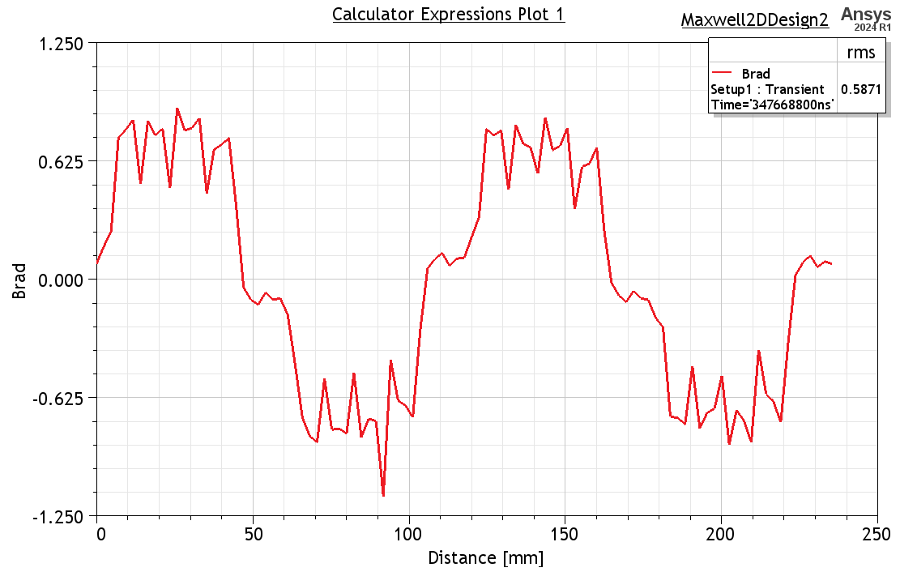
0.3mm eccentricity fault(60%)

Slide 12
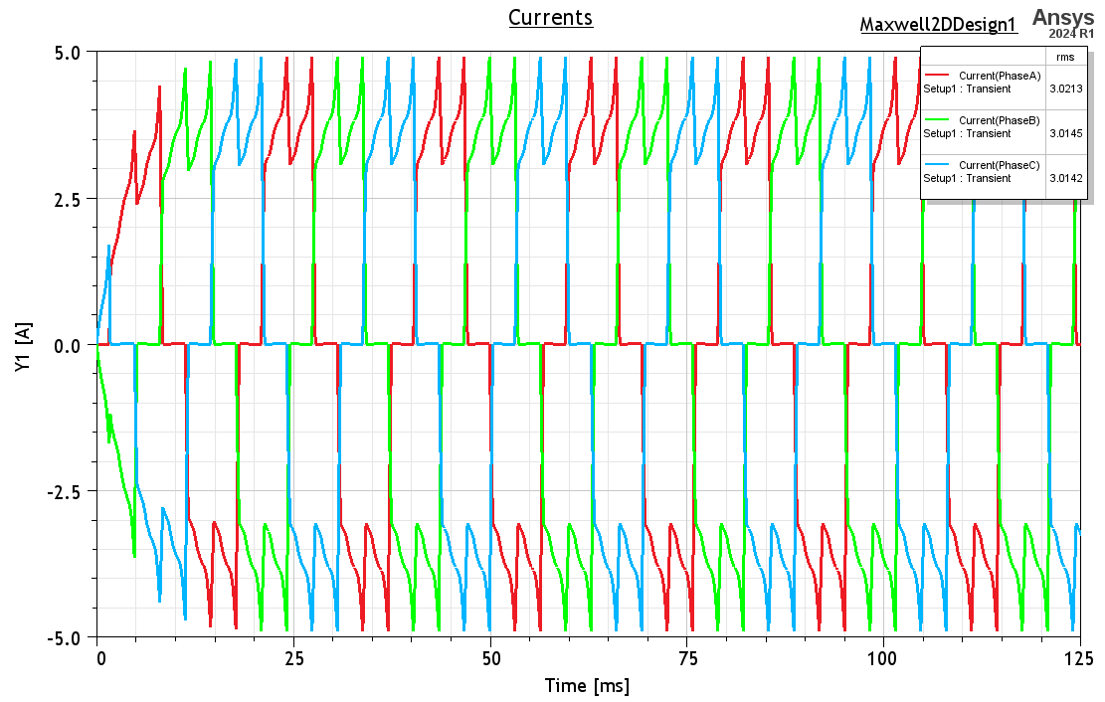
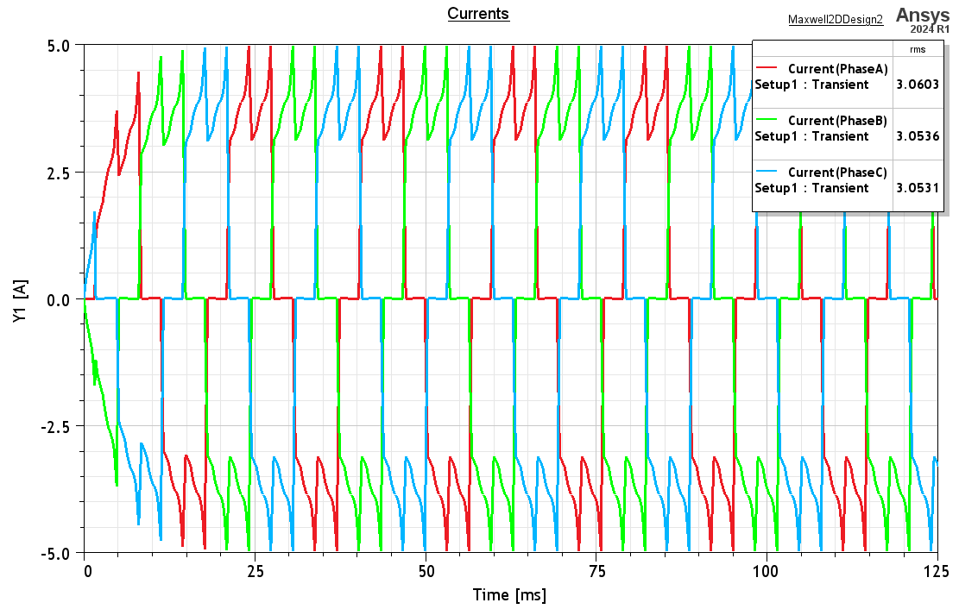
Current graphs
Healthly
0.1mm eccentricity fault(20%)

Slide 13
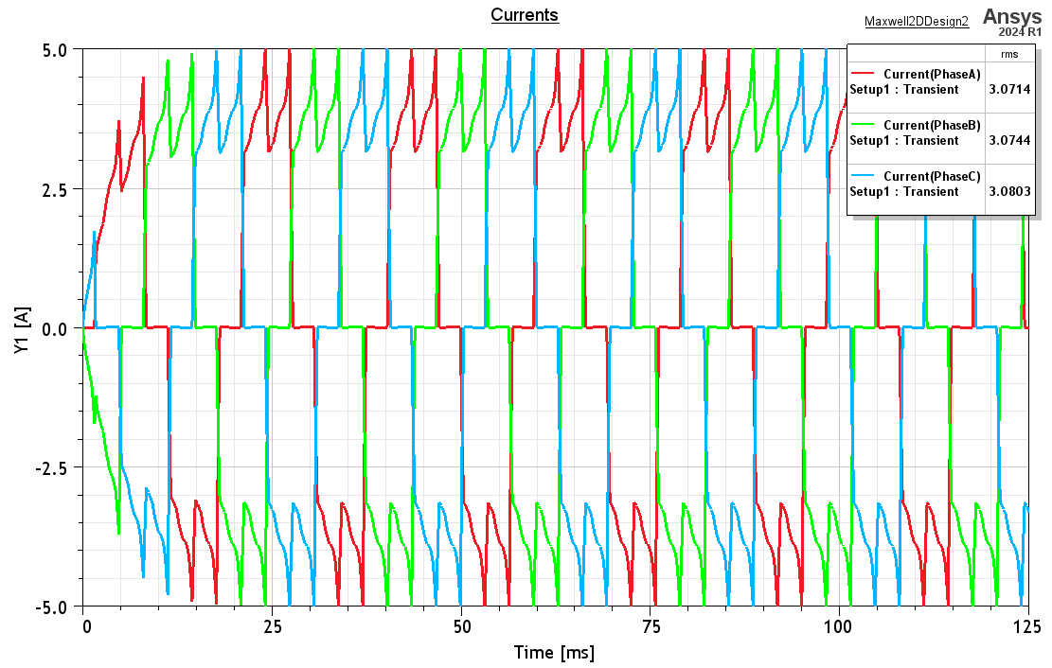
0.3 mm eccentricity fault(60%)

Slide 14
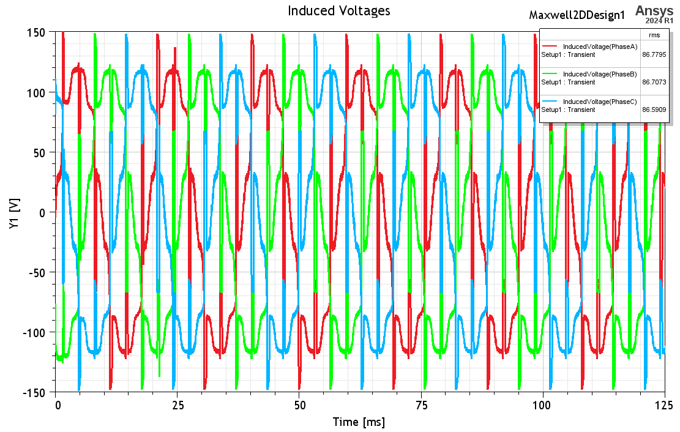
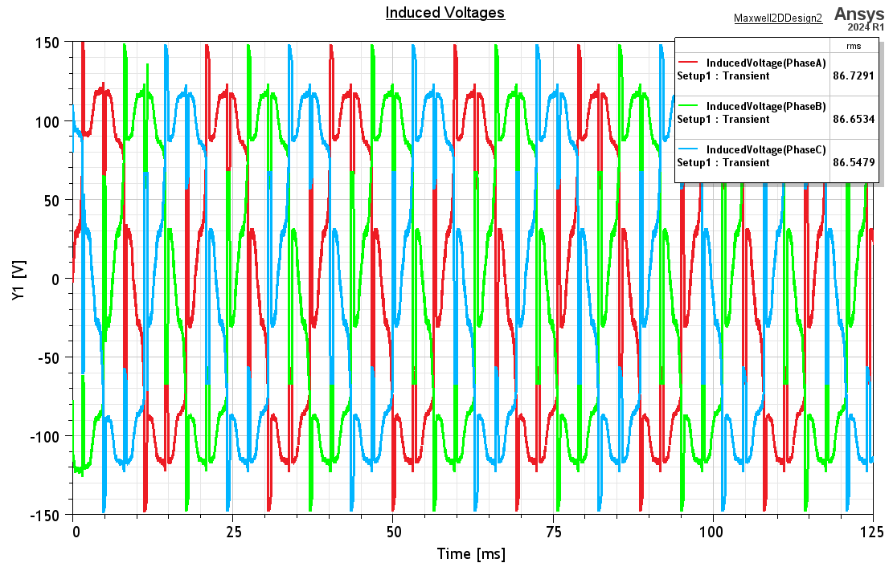
Induced voltage graphs
Healthly
0.1mm eccentricity fault(20%)

Slide 15
0.3mm eccentricity fault(60%)

Slide 16
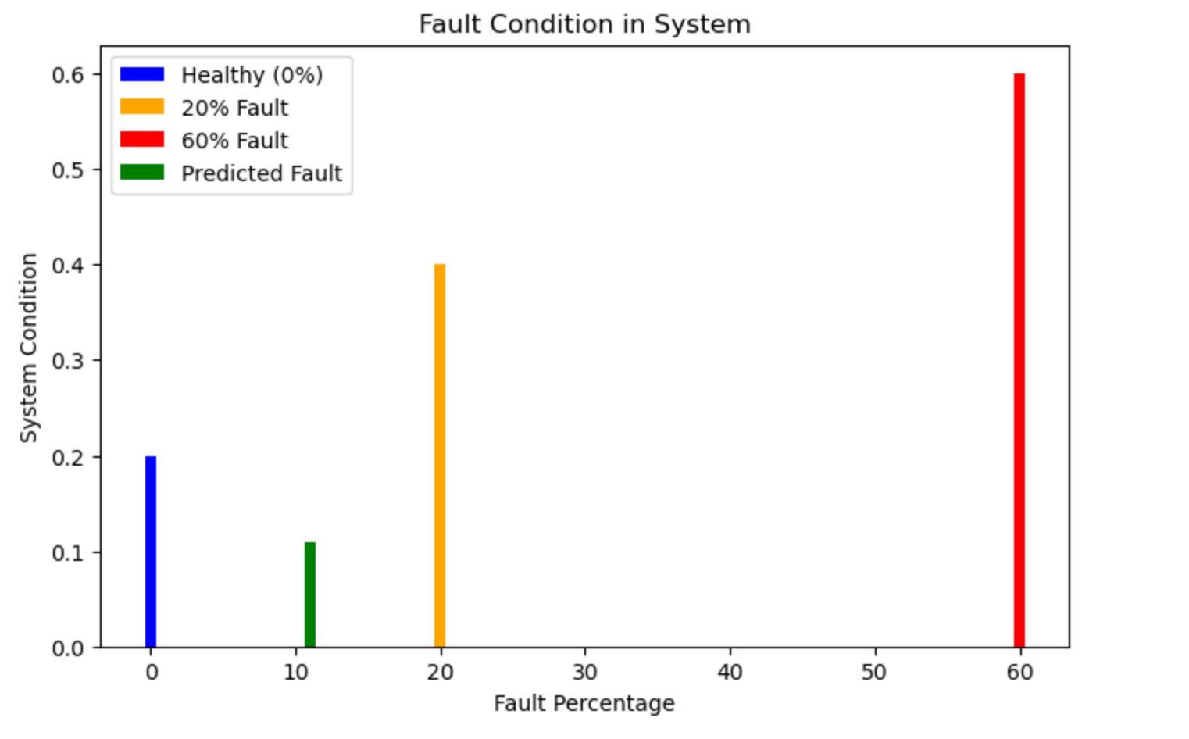
Fault Prediction using Machine learning
11% fault input values
Phase | RMS(A) | PeaK(A) | Mean(A)
Phase A | 2.85 | 4.90 | 0.35
Phase B | 2.87 | 4.92 | 0.02
Phase C | 2.89 | 4.95 | -0.38

Slide 17
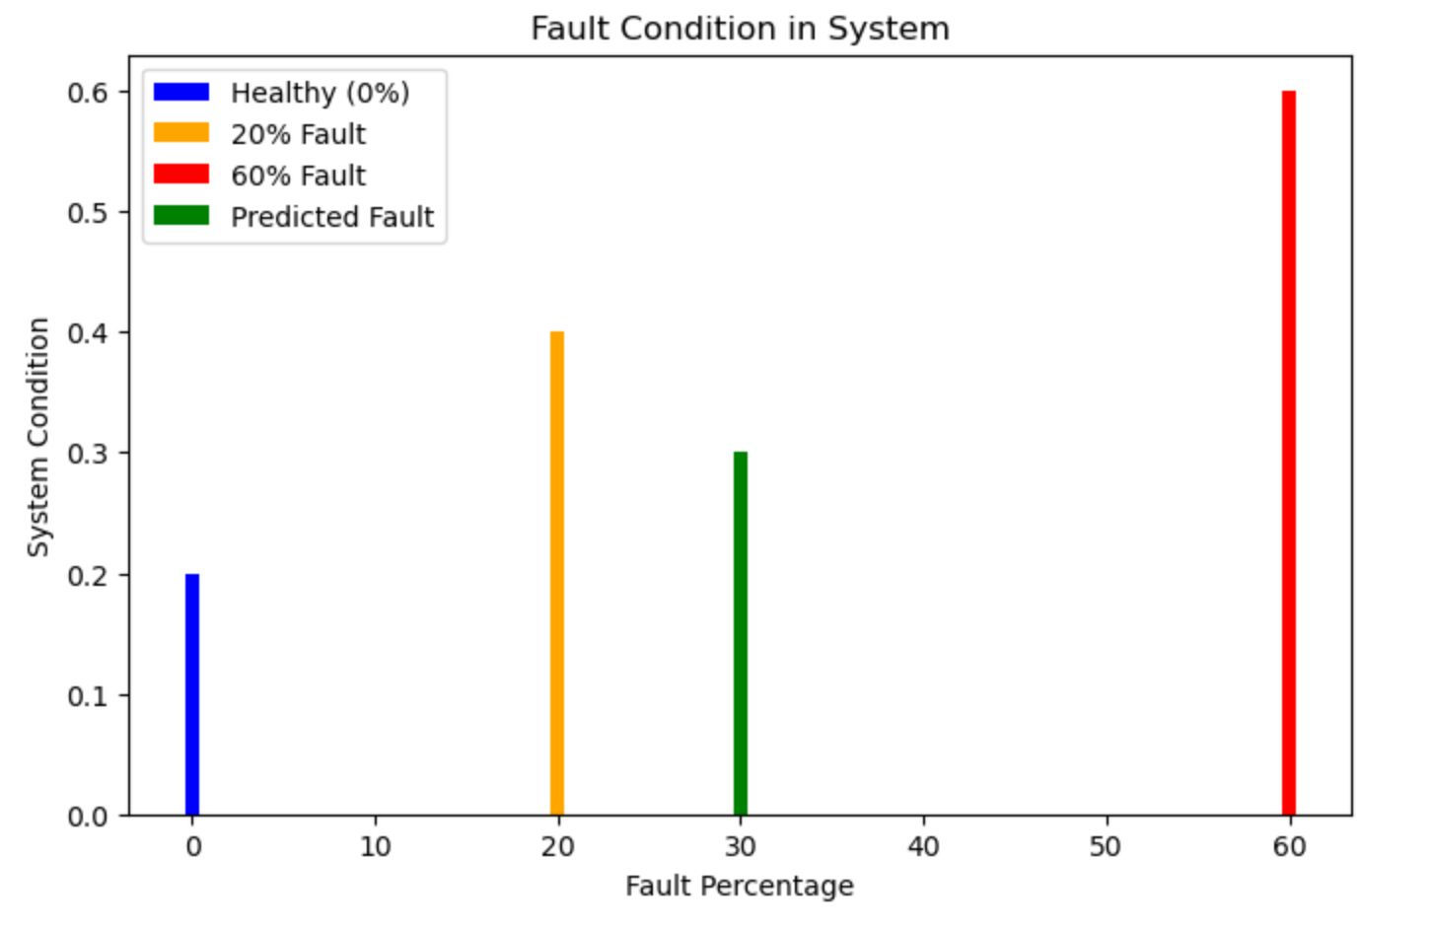
30% fault input values
Phase | RMS(A) | Peak(A) | Mean(A)
Phase A | 2.89 | 4.97 | 0.37
Phase B | 2.91 | 4.97 | 0.03
Phase C | 2.98 | 4.97 | -0.41

Slide 18
Conclusion
The analysis and simulation of Brushless DC (BLDC) motors using ANSYS Maxwell provide valuable insights into the electromagnetic behavior, fault diagnosis, and performance optimization of electric vehicle (EV) motors. Through finite element analysis (FEA), various fault conditions—such as magnetic flux distortions, induced voltage variations, and torque ripple—were examined to understand their impact on motor efficiency and reliability.
The results demonstrate that faults such as winding short circuits, rotor misalignment, and magnet demagnetization significantly affect torque performance, voltage characteristics, and magnetic flux distribution. By simulating these faults, early detection techniques can be developed, leading to better predictive maintenance strategies that reduce the risk of motor failure and extend the motor's operational life.

